Slide 1
From Plagiarism to Academic Excellence
Trusted by 15,000 Institutions and 2 Million Instructors
Notes:
Thanks for taking the time to meet with me today.
This presentation is based on the conversations we’ve had with your institution and is informed by the journey we’ve gone on with thousands of higher education institution.
We call this journey “From Plagiarism to Academic Excellence”.

Slide 2
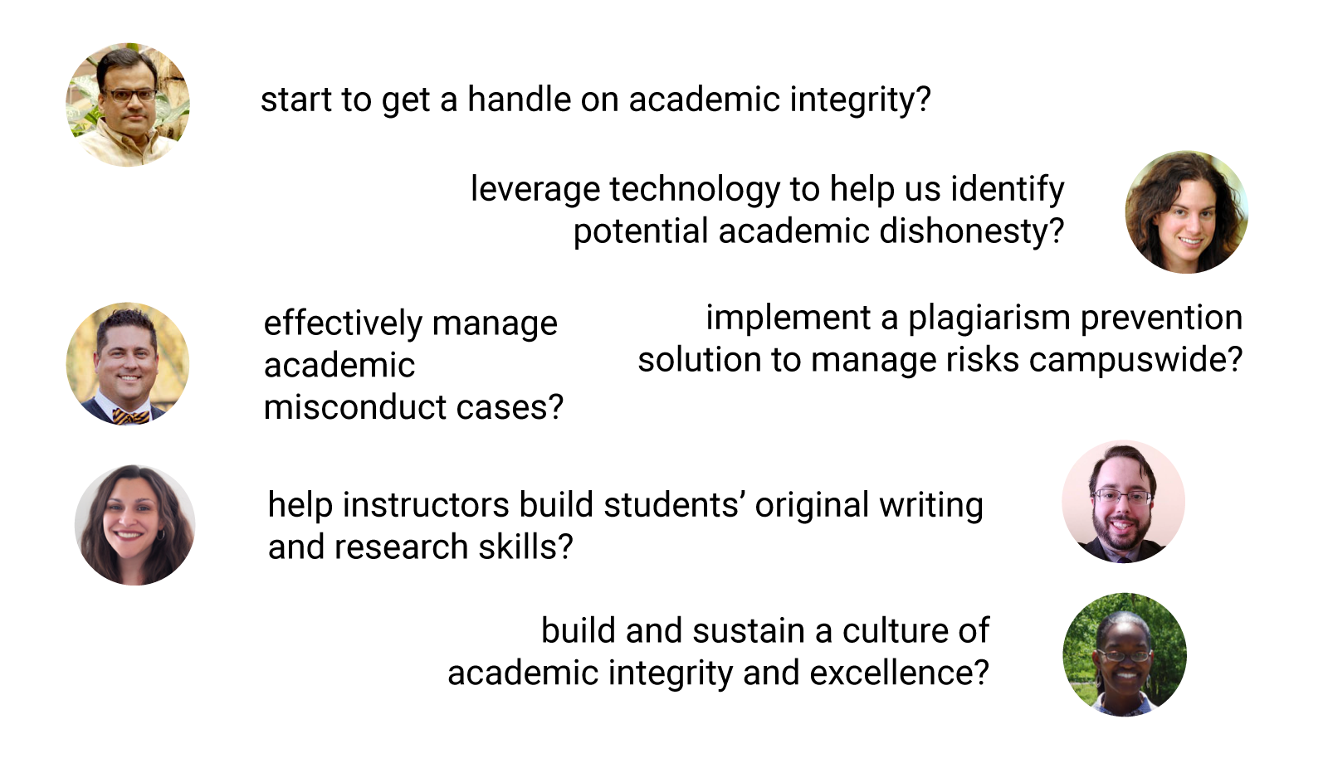
Your Partner in Education with Integrity
“How Can We…”
Notes:
Academic integrity means a lot of things to a lot of people. Over the years, Turnitin has partnered with institutions around the country to enhance academic integrity and promote academic excellence--whatever that means to them. Some institutions come to us and ask...
… start to get a handle on academic integrity?
… leverage technology to help us identify potential academic dishonesty?
… effectively manage academic misconduct cases?
... implement a plagiarism prevention solution to manage risks campuswide?
… help instructors build students’ original writing and research skills?
… build and sustain a culture of academic integrity and excellence?
Today, we’re here to discuss does it mean to you, and how can we help?
[Focus on the perspective of the customer and the possible issues they may be encountering, regarding academic integrity.
Move quickly from us to the customer; move quickly from an emphasis on plagiarism to an emphasis on academic excellence.
Present this as the range of what we do; wherever your institution may be on this journey, we can help.]

Slide 3
Plagiarism Isn’t Just a Cheating Issue
Norms for Collaboration
Time Management
English
Proficiency
Nontraditional
Students
Vocabulary
Citation
Skills
Grammar
Paraphrasing
Skills
Voice
Critical Thinking
Argumentation
Notes:
What we’ve learned working with institutions for close to two decades is that plagiarism isn’t just a cheating issue. Instead it is a symptom of other challenges students have as they begin writing at the college level.
Starting at the top and moving clockwise, some of the skills issues plagiarism reveals include:
Time management skills: avoiding needs to rush and take shortcuts
Nontraditional students (e.g. ppl returning to school; balancing a job/family with education, veterans)
Understanding citation - and why we attribute
Understanding how to summarize ideas in original language (paraphrasing)
Knowing how to express thoughts and ideas in a convincing manner (argumentation)
Having the critical thinking skills to produce original ideas
Knowing how to write in one’s own voice
Knowledge of grammar rules and vocabulary
Comfort with the English language (English Proficiency)
Understanding norms for appropriate collaboration
Strong college-level writing skills impact students’ futures – and institutions’ reputations.

Slide 4
Plagiarism Isn’t Just a Cheating Issue
Strong univeristy-level writing skills
impact students’ futures –
and institutions’ reputations.
Notes:
So to summarize: Plagiarism isn’t just a cheating issue - it reveals a fundamental writing skills gap that has consequences for your students’ future, and therefore for your institution’s reputation. Studies support the importance of writing in being among the strongest predictors of college success-- almost on par or just as high in predictability as high school grades. A report by the University of Georgia found that the SAT® Writing Essay results were the single, strongest predictor of future college success of the factors they studied. Cornwell, C., Mustard, D. and Van Parys, J. (2009). The New SAT® and Academic Performance in the First Year of College. University of Georgia. Also: A report from UC Berkeley found that the SAT II Writing Test was the most effective predictor of college success, after high school grades. Geiser, S. and Santelices, M.V. (2007). Validity of High-School Grades in Predicting Student Success Beyond the Freshman Year: High-School Record vs. Standardized Tests as Indicators of Four-Year College Outcomes. Research and Occasional Paper Series: California Studies in Higher Education: 6.07.

Slide 5
Original Insights. Better Writers.
Notes:
So we’ll begin today by taking a look at Turnitin’s flagship product, Turnitin Feedback Studio.
Feedback Studio isn’t just about plagiarism though it will help to protect your institution's reputation.
Turnitin Feedback Studio also helps institutions raise academic and institutional success to a whole new level.

Slide 6
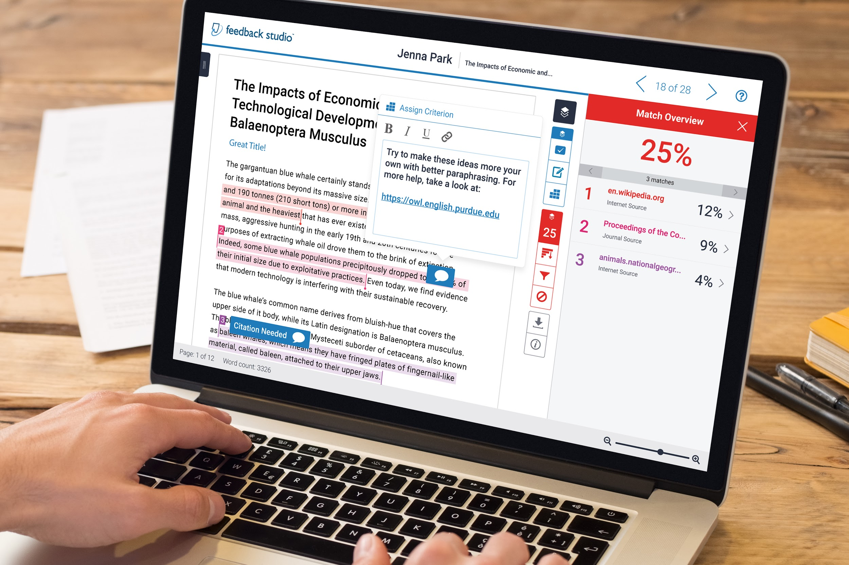
Notes:
How does Turnitin Feedback Studio address plagiarism and the underlying skills gap?
Turnitin Feedback Studio helps colleges and universities take an Institutional approach to preventing plagiarism through by both reducing risk to your institution and improving student writing skills.
Feedback Studio’s originality checking tools:
1. Helps instructors and administrators efficiently and confidently manage potential academic dishonesty
Saves teachers’ time by instantly detecting plagiarized material
Identifies exact source of plagiarized material to aid in investigations
Prevents student collusion with massive database of previous student papers
Avoids academic fraud and retraction of high-stakes papers with exclusive access to massive database of scholarly content (journal articles, textbooks, etc.)
Avoid potential scandal of awarding degrees based on falsified theses/dissertations
Motivates students to avoid shortcuts & cheating
2. Helps students self-identify and correct issues with their academic writing
Student facing similarity reports help students see areas where they need to improve their citations and paraphrasing
3. Helps instructors efficiently provide the kinds of instructional support that lead to academic success in writing & beyond
Allows instructors to quickly provide students with multiple types of personalized feedback, including feedback on research & citation
Helps align feedback with desired student learning outcomes
Combines all feedback in one place so students can easily apply it
Promotes alignment and scaling of best practices across an institution

Slide 7
Prevent Plagiarism with the
Highest Level of Confidence
Avoid Academic &
Research Misconduct
Discourage Improper Collaboration
Prevent Copy-Paste Culture
165 million
700 million
62 billion
journal articles, including Crossref content
student papers and dissertations
current and archived web pages
Notes:
You have other options for trying to prevent plagiarism but Turnitin is the only solution that allows you to do so with the highest level of confidence.
We do this by tackling the three most common forms of plagiarism: Research misconduct (CrossRef), Student Collusion (student papers), Search Plagiarism (copy-paste)
Research Misconduct
Turnitin is the only program that indexes leading scholarly and academic work to avoid Academic & Research Misconduct. We ensure the originality of research papers, including theses and dissertations, by comparing to 165 million journal articles through Turnitin’s publisher partnerships, including Crossref.
Search Plagiarism
We prevent Search plagiarism, also known as the Copy-Paste Culture that is growing in frequency in all facets of society. We crawl and index 65 billion current and archived web pages to encourage original thought and promote proper citation.
Discourage Improper Collaboration
We’re the only service that has the size to combat the most common form of plagiarism which is recycled and shared work between students on the Web. Turnitin’s index of over 700 million student papers discourages students from improperly sharing work by providing instant matches to this source material.

Slide 8
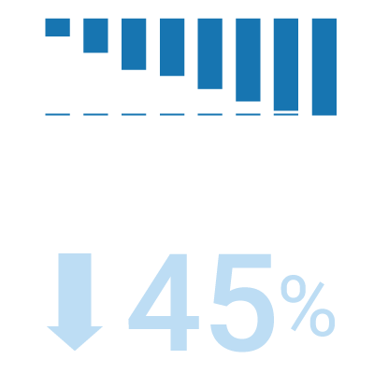
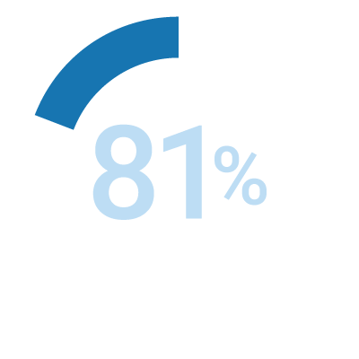
Proven Results
Turnitin has helped over 15,000 institutions and 30 million students.
decrease in unoriginal content¹
students who believe that Feedback Studio helped them avoid plagiarism²
1 Turnitin (2012). Survey of 350 customers. 2 Turnitin (2016). From Here to There: Students’ Perceptions on Feedback Goals, Barriers, and Effectiveness.
Notes:
We’ve achieved proven results with thousands of institutions worldwide.
Higher education institutions who use Turnitin see a median reduction of 45 percent in unoriginal content over five years of use.
And in surveys to students, 81% believe that Turnitin helped them avoid plagiarism.

Slide 9
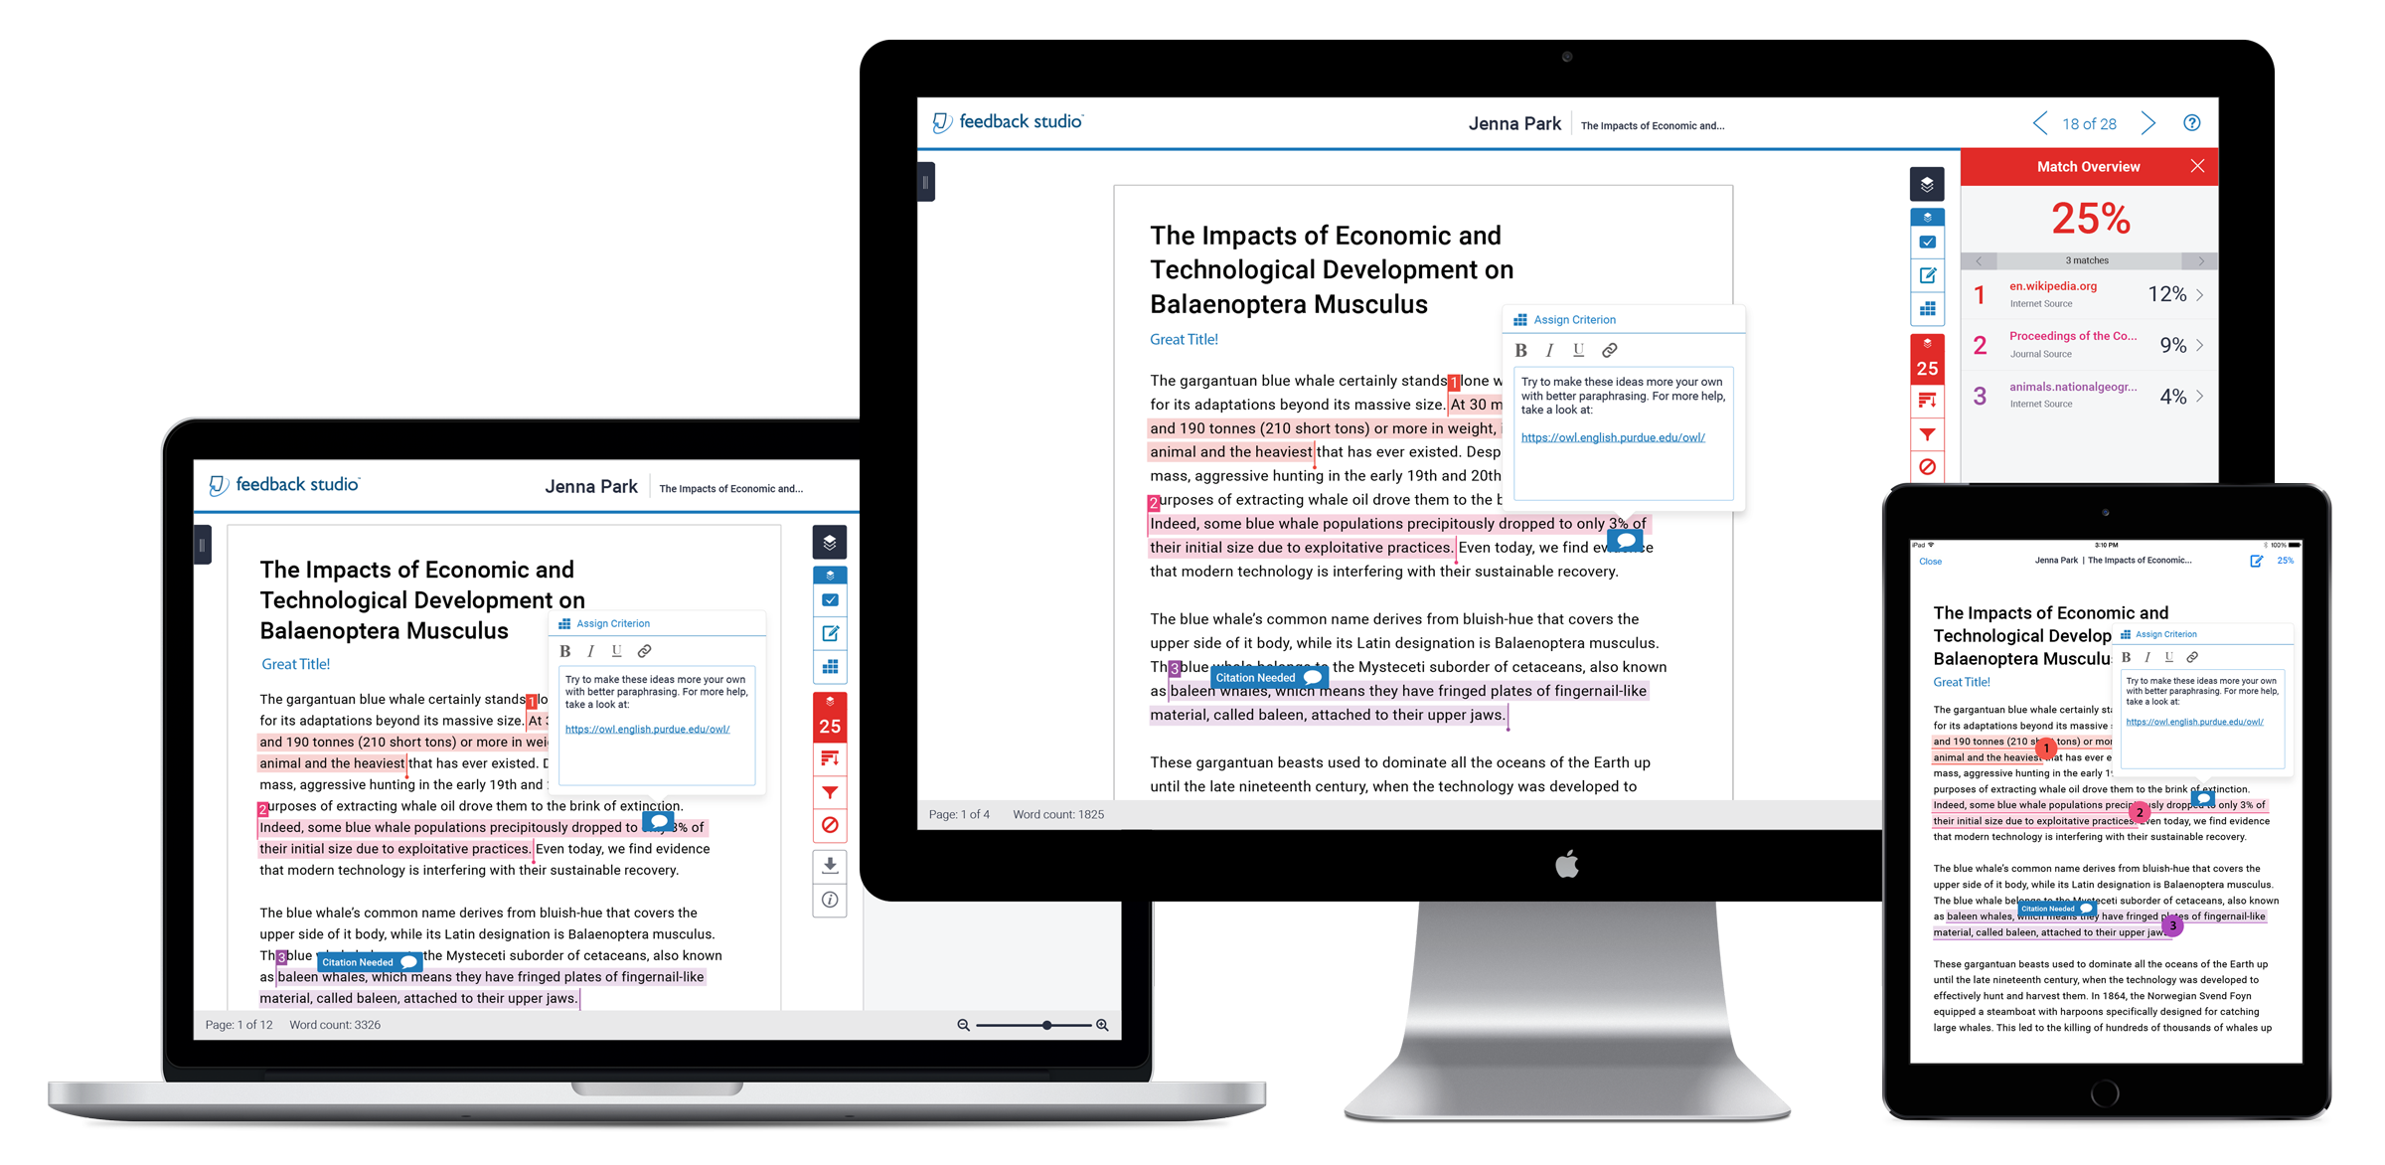
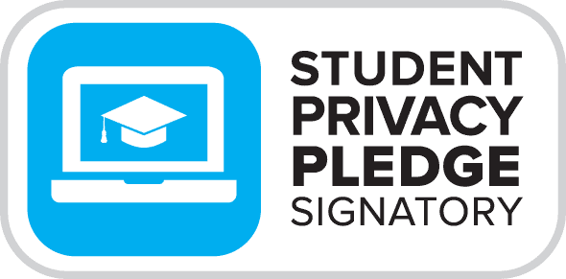
Accessible and Secure
Notes:
We place accessibility, security and data privacy as key design considerations for Turnitin Feedback Studio in order to support mobile use, students with special needs, and to ensure the protection of student information.
We take security very seriously and are signatories of the Student Privacy Pledge, put forth by the Future of Privacy Forum (FPF) and the Software & Information Industry Association (SIIA)--the gold standard for US ed tech.

Slide 10
Student Paper Repository
Discourage improper collaboration
& prevent student collusion
1.3 billion student papers
Institutional Repository
A private repository that other institutions cannot match against
Current & Archived Internet
Prevent copy-paste
culture
85+ billion archived web pages
Scholarly Repository
Avoid academic
& research misconduct
170+ million journals and publications

Slide 11
Similarity Reports can be generated for the following file types:
Microsoft Word® (.doc / .docx)
Microsoft PowerPoint® (.ppt / .pptx / .pps / .ppsx)
Microsoft Excel® (.xls / .xlsx)
Adobe® PDF (.pdf)
Adobe® PostScript (.ps / .eps)
OpenOffice Text (.odt)
Corel WordPerfect® (.wpd)
Google Docs (via Google Drive™ picker)
Google Slides (via Google Drive™ picker)
Google Sheets (via Google Drive™ picker)
HTML
Plain text (.txt)
Rich text format (.rtf)
Hangul (.hwp)
Students using Apple Pages? Click on File > Export to > PDF

Slide 12
The file uploaded must:
Have password protection turned off
Contain more than 20 words
Be less than 800 pages in length
Be less than 100 MB in size

Slide 13
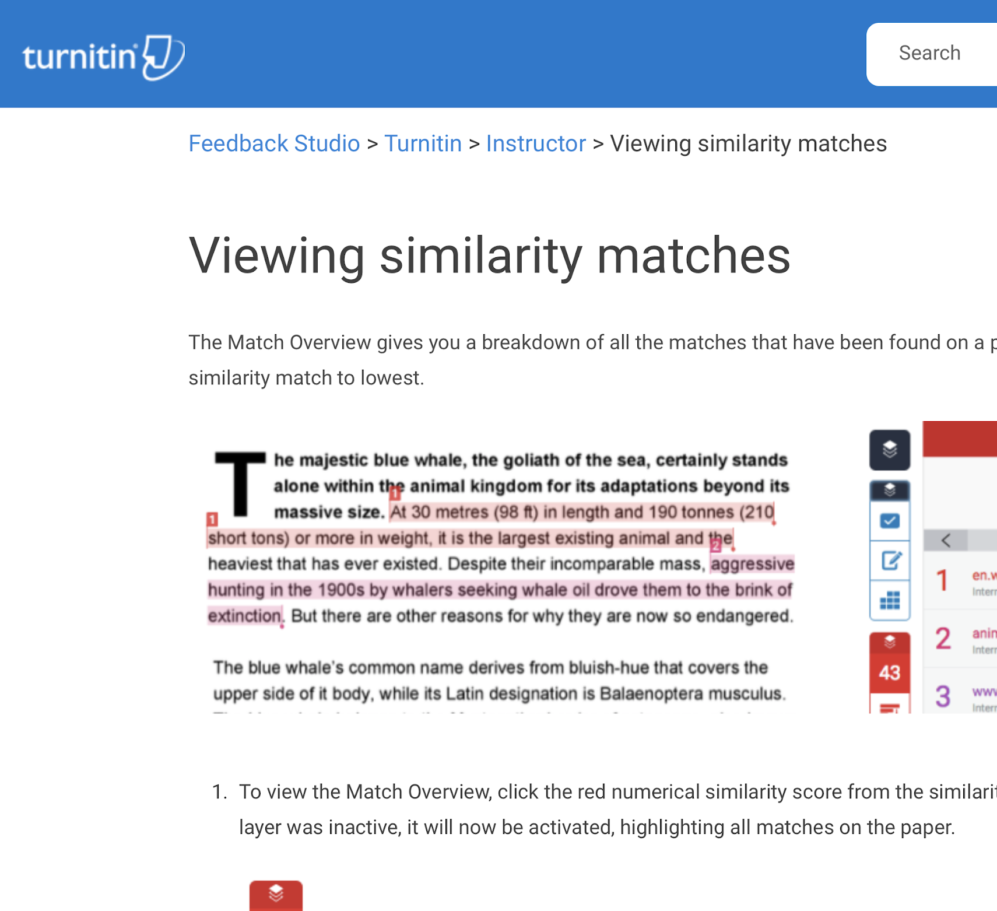
Getting Help with Feedback Studio
1 Begin with the Instructor QuickStart Guide
Instructor QuickStart Guide
Student QuickStart Guide
2 Search the Self Help guides
help.turnitin.com
3 Contact your institution’s Administrator

Slide 14
Customized Live Demo
Notes:
Thanks for your time today. I would now like to jump into a live demo and show you some of what I just talked about.
Because we discussed some of the challenges with [fill in institutional needs/challenges] that your institution is looking for support with, I’ll be focusing on capabilities that directly address those needs.

Slide 15
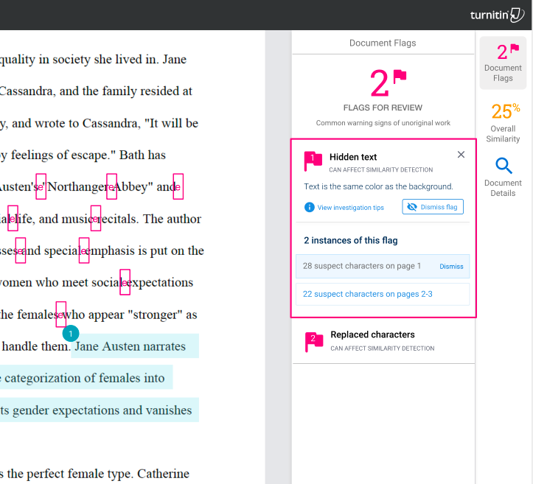
Discover Similarity
to Known Works
Reveal text modifications meant to circumvent the human eye and automated integrity checks:
White text
Character replacement
Abnormally high amount of quoted material
https://help.turnitin.com/feedback-studio/flags.htm

Slide 16
Frequently Asked Questions:
How long is Turnitin subscription?
What is the acceptable percentage for Turnitin?
Does Turnitin detects plagiarism?
The similarity score shows the percentage of plagiarized content in a student’s paper?
An instructor can determine if a paper is acceptable purely from the similarity score and doesn't need to look at the Similarity Report?
Papers in the Turnitin database are easily accessible by others so privacy is not protected?
Once a paper has been submitted to Turnitin, it is in the database forever?
All words, big or small, could be mistaken for a match in a Similarity Report?
Turnitin compares a paper against everything ever written?
Why we subscribe to Turnitin instead of the “FREE” one on internet?
Using Turnitin create more tasks for lecturer?
ILLEGAL RESELLER

Slide 17
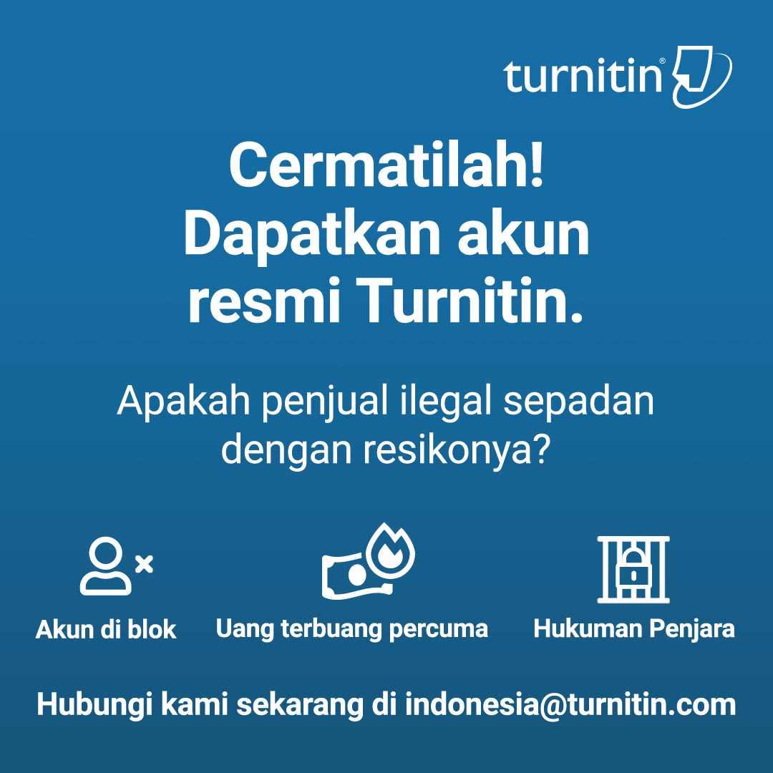

Slide 18
Questions?
Contact:
For Existing Customer
Christine Ririana: cririana@turnitin.com
For New Customer
indonesia@turnitin.com
Notes:
Thank you for your time today. Now, I’d like to open it up to questions.
Thanks for your time today. I would now like to jump into a demo and show you some of what I just talked about.

